Slide 1


Exposure Java 2013
APCS Edition
Chapter 16 Slides
Strings and Re-defining Methods
PowerPoint Presentation
created by:
Mr. John L. M. Schram
and Mr. Leon Schram
Authors of Exposure Java

Slide 2
Section 16.1
Introduction to
String Methods

Slide 3
String Processing
Word processing term papers, writing memoirs, sending email messages, responding to surveys, placing online orders and registering products all involve string processing.
Every software package on the market includes string-processing components.
Every programming language has special features that facilitate the manipulation of strings, and Java is no different.

Slide 4
String Definition
A String is a set of characters that behaves as a single unit.
The characters in a String include upper-case and lower-case letters, numerical characters and a large set of characters for a variety of purposes like:
! @ # $ % ^ & * ( ) _ +

Slide 5
String Variables vs. String Literals
A string literal is a set of characters delimited with double quotations.
String name = “John Smith”;
name is the string variable.
“John Smith” is the string literal.

Slide 6
Section 16.2
Constructing
String Objects

Slide 7
Is String a Simple Data Type?
When you see statements like:
which looks very similar to
you might get the idea that String is a simple
(or primitive) data type like int, double, char, and boolean. However, String is NOT a simple data type. String is a class.
String name = “John”;
int x = 5;

Slide 8
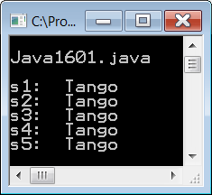
// Java1601.java
// This program demonstrates multiple ways to construct String objects.
// Note that all five string objects store the same information.
public class Java1601
{
public static void main (String args[])
{
System.out.println("\nJava1601.java\n");
String s1 = "Tango";
System.out.println("s1: " + s1);
String s2 = new String(); // Default constructor
s2 = "Tango";
System.out.println("s2: " + s2);
String s3 = new String("Tango"); // Overloaded constructor with String parameter
System.out.println("s3: " + s3);
String s4 = new String(s3); // Same constructor as s3
System.out.println("s4: " + s4);
char dance[ ] = {'T','a','n','g','o'};
String s5 = new String(dance); // Overloaded constructor with char array parameter
System.out.println("s5: " + s5);
System.out.println();
}
}

Slide 9
Section 16.3
String
Method
length

Slide 10
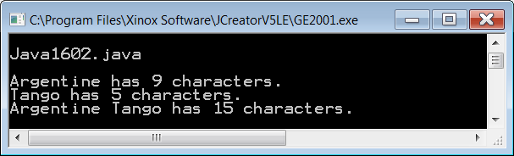
// Java1602.java
// This program demonstrates the use of the <length> method.
public class Java1602
{
public static void main (String args[])
{
String s1 = "Argentine";
String s2 = "Tango";
String s3 = s1 + " " + s2;
System.out.println(s1 + " has " + s1.length() + " characters.");
System.out.println(s2 + " has " + s2.length() + " characters.");
System.out.println(s3 + " has " + s3.length() + " characters.");
System.out.println();
}
}

Slide 11
String Method length
int count = str.length();
Method length returns the length or number of characters in the String object.
If str equals "Aardvark" then count becomes 8.
The Java static array uses the length field.
The dynamic ArrayList class uses the size method.

Slide 12
Section 16.4
Working with
Substrings

Slide 13
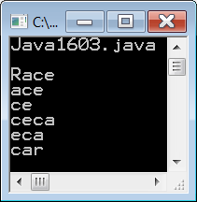
// Java1603.java
// This program demonstrates how to access specified characters of a string
// with the <substring(SI,EI)> method, where SI is the Starting Index and
// EI is one more than the Ending Index.
public class Java1603
{
public static void main (String args[])
{
System.out.println("\nJava1603.java\n");
String s = "Racecar";
System.out.println(s.substring(0,4));
System.out.println(s.substring(1,4));
System.out.println(s.substring(2,4));
System.out.println(s.substring(2,6));
System.out.println(s.substring(3,6));
System.out.println(s.substring(4,7));
System.out.println();
}
}
0 | 1 | 2 | 3 | 4 | 5 | 6
R | a | c | e | c | a | r

Slide 14
String Method substring
s1 = “Aardvark”;
s2 = s1.substring(j,k);
Method substring returns a set of consecutive characters from String s1, starting at index j, and ending at index k-1.
s3 = s1.substring(4,7);
s3 becomes "var"
s1 | 0 | 1 | 2 | 3 | 4 | 5 | 6 | 7
 | A | a | r | d | v | a | r | k

Slide 15
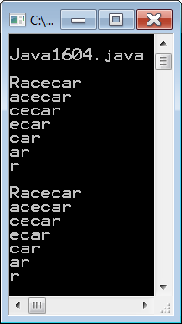
// Java1604.java
// This program compares the two <substring> methods.
public class Java1604
{
public static void main (String args[])
{
System.out.println("\nJava1604.java\n");
String s = "Racecar";
int n = s.length();
for (int k = 0; k < n; k++)
System.out.println(s.substring(k));
System.out.println();
for (int k = 0; k < n; k++)
System.out.println(s.substring(k, n));
System.out.println();
}
}
0 | 1 | 2 | 3 | 4 | 5 | 6
R | a | c | e | c | a | r

Slide 16
Overloaded String Method substring
s1 = “Aardvark”;
s2 = s1.substring(j);
Method substring returns a set of consecutive characters from String s1, starting at index j,
and continuing all the way to the end of the string.
s3 = s1.substring(4);
s3 becomes "vark"
s1 | 0 | 1 | 2 | 3 | 4 | 5 | 6 | 7
 | A | a | r | d | v | a | r | k

Slide 17
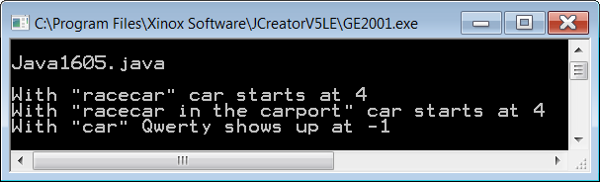
// Java1605.java
// This program shows the <indexOf> method, which returns the index of the first
// occurrence of the string argument or -1 if the string is not found.
public class Java1605
{
public static void main (String args[])
{
System.out.println("\nJava1605.java\n");
String s1 = "racecar";
String s2 = "racecar in the carport";
String s3 = "car";
int index1 = s1.indexOf(s3);
int index2 = s2.indexOf(s3);
int index3 = s3.indexOf("qwerty");
System.out.println("With \"" + s1 + "\" car starts at " + index1);
System.out.println("With \"" + s2 + "\" car starts at " + index2);
System.out.println("With \"" + s3 + "\" Qwerty shows up at " + index3);
System.out.println();
}
}

Slide 18


String Method indexOf
indexOf returns the first occurrence
of a substring
s1.indexOf(“hum”); returns 0
s1.indexOf(“ku”); returns 10
s1.indexOf(“qwerty”); returns -1
If the substring cannot be found
a value of -1 is returned.
s1 | 0 | 1 | 2 | 3 | 4 | 5 | 6 | 7 | 8 | 9 | 10 | 11 | 12 | 13 | 14 | 15 | 16 | 17 | 18 | 19 | 20 | 21
 | h | u | m | u | h | u | m | u | n | u | k | u | n | u | k | u | a | p | u | a | ’ | a
By the way,
it is the State Fish of Hawaii.

Slide 19
Section 16.5
Converting
Strings

Slide 20
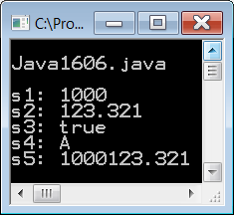
// Java1606.java
// This program demonstrates the <valueOf> method of the String class,
// which is shown to convert four data types to a string.
// Note that <valueOf> is a static method and must be called using <String.valueOf>.
public class Java1606
{
public static void main (String args[])
{
System.out.println("\nJava1606.java\n");
String s1 = String.valueOf(1000);
String s2 = String.valueOf(123.321);
String s3 = String.valueOf(true);
String s4 = String.valueOf('A');
String s5 = s1 + s2;
System.out.println("s1: " + s1);
System.out.println("s2: " + s2);
System.out.println("s3: " + s3);
System.out.println("s4: " + s4);
System.out.println("s5: " + s5);
System.out.println();
}
}

Slide 21
String static Method valueOf
String s1 = String.valueOf(1000);
String s2 = String.valueOf(123.321);
String s3 = String.valueOf(true);
String s4 = String.valueOf('A');
Method valueOf converts the provided parameter and returns a string. Four overloaded valueOf methods are displayed.
Note that the valueOf method is a static method (or class method) that is called with the String class identifier.

Slide 22
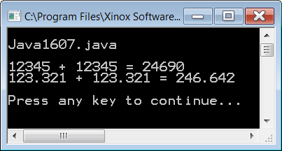
// Java1607.java
// This program converts string values to integer and double values
// using the <parseInt> and <parseDouble> methods of the
// <Integer> and <Double> classes.
public class Java1607
{
public static void main (String args[])
{
String s1 = "12345";
String s2 = "123.321";
int n1 = Integer.parseInt(s1);
double n2 = Double.parseDouble(s2);
System.out.println(n1 + " + " + n1 + " = " + (n1 + n1));
System.out.println(n2 + " + " + n2 + " = " + (n2 + n2));
System.out.println();
}
}

Slide 23
Integer static method parseInt and Double static method parseDouble
int n1 = Integer.parseInt(s1);
double n2 = Double.parseDouble(s2);
Method parseInt converts a String into an int.
Method parseDouble converts a String into a double.
Parameters that include non-numerical characters will compile, but will cause a
run-time error.

Slide 24
Section 16.7
Comparing
Strings

Slide 25
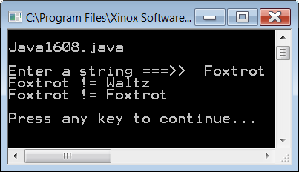
// Java1608.java
// This program checks equality of strings using the == operator.
// This program has unexpected results.
public class Java1608
{
public static void main (String args[])
{
System.out.println("\nJava1608.java\n");
Scanner input = new Scanner(System.in);
String s1 = "Foxtrot";
String s2 = "Waltz";
System.out.print("Enter a string ===>> ");
String s3 = input.nextLine();
if (s1 == s2)
System.out.println(s1 + " == " + s2);
else
System.out.println(s1 + " != " + s2);
if (s1 == s3)
System.out.println(s1 + " == " + s3);
else
System.out.println(s1 + " != " + s3);
System.out.println();
}
}

Slide 26

// Java1609.java
// This program demonstrates the <equals> method, which is capable of
// testing equality of string objects correctly.
public class Java1609
{
public static void main (String args[])
{
System.out.println("\nJava1609.java\n");
Scanner input = new Scanner(System.in);
String s1 = "Foxtrot";
String s2 = "Waltz";
System.out.print("Enter a string ===>> ");
String s3 = input.nextLine();
if (s1.equals(s2))
System.out.println(s1 + " == " + s2);
else
System.out.println(s1 + " != " + s2);
if (s1.equals(s3))
System.out.println(s1 + " == " + s3);
else
System.out.println(s1 + " != " + s3);
System.out.println();
}
}

Slide 27
What Is Going On? Part 1
int x = 10;
int y = 10;
int z = 20;
x
10
y
10
z
20
The equality operator == works with
primitive data types like int.
x == y x != z

Slide 28
What Is Going On? Part 2
s1
@dff6ccd
s2
@3b0eb0
s3
@18d107f
dff6ccd
Foxtrot
3b0eb0
Waltz
18d107f
Foxtrot
The equality operator == does not work with objects because
it compares the Shallow Values which are memory addresses.

Slide 29
What Is Going On? Part 3
s1
@dff6ccd
s2
@3b0eb0
s3
@18d107f
dff6ccd
Foxtrot
3b0eb0
Waltz
18d107f
Foxtrot
The equals method should be used with objects like Strings because
it compares the Deep Values which is the actual information stored.

Slide 30
The Bottom Line
If you are comparing simple data types like 2 ints, 2 doubles, 2 chars or 2 booleans, use the == operator.
If you are comparing objects – and Strings are objects – you need to use the equals method.
The String class has its own equals method.
For other classes, you have to create your own.

Slide 31
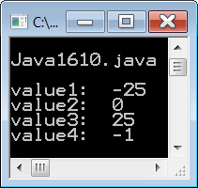
// Java1610.java
// This program demonstrates the <compareTo> method, which returns an integer value.
// The returned value indicates which string alphabetically goes before the other.
// If the value is negative, the original string goes first.
// If the value is positive, the parameter string goes first.
// If the value is zero, both strings are equal.
public class Java1610
{
public static void main (String args[])
{
System.out.println("\nJava1610.java\n");
String s1 = "AARDVARK";
String s2 = "ZEBRA";
String s3 = "AARDVARK";
String s4 = "BART";
int value1 = s1.compareTo(s2);
int value2 = s1.compareTo(s3);
int value3 = s2.compareTo(s1);
int value4 = s1.compareTo(s4);
System.out.println("value1: " + value1);
System.out.println("value2: " + value2);
System.out.println("value3: " + value3);
System.out.println("value4: " + value4);
System.out.println();
}
}

Slide 32
String methods equals and compareTo
if (s1.equals(s2))
int difference = s3.compareTo(s4);
Method equals returns true if s1 is equal
to s2, and false otherwise.
Method compareTo returns an int value
based on the difference between s3 and s4.
If the int value is 0, s3 and s4 are equal.
If the int value is negative, s3 goes before s4.
If the int value is positive, s3 goes after s4.

Slide 33
AP Exam Alert
Many String methods have been introduced.
Not all of these methods will be tested. Only the following methods are part of the AP Java Subset:
compareTo equals length substring indexOf

Slide 34
Section 16.7
Introduction to
Re-defining Methods

Slide 35
toString & equals
You have seen that the String class has an equals method to check if 2 strings are equal.
You have also seen that various GridWorld classes, like Actor and Grid have a toString method.
It was stated that this method assists with debugging.
It turns out that these 2 methods have been defined for several Java classes. These methods can also be defined for any user-defined class.

Slide 36
Section 16.8
The Object Class

Slide 37
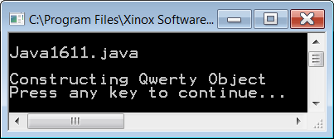
// Java1611.java
// This program intentional extends the two classes with
// Object as the superclass. This is done automatically.
import java.util.ArrayList;
public class Java1611 extends Object
{
public static void main (String args[])
{
System.out.println("\nJava1611.java\n");
Qwerty q = new Qwerty();
}
}
class Qwerty extends Object
{
public Qwerty()
{
System.out.println("Constructing Qwerty Object");
}
}

Slide 38
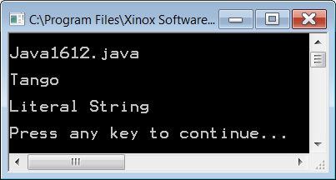
// Java1612.java
// This demonstrates how <String> class objects are printed.
public class Java1612
{
public static void main (String args[])
{
System.out.println("\nJava1612.java\n");
String stringVar = "Tango";
System.out.println(stringVar);
System.out.println();
System.out.println("Literal String");
System.out.println();
}
}

Slide 39
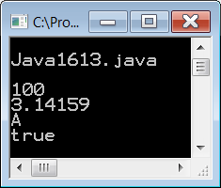
// Java1613.java
// This demonstrates how <int>, <double>, <char> and <boolean>
// variables are printed.
public class Java1613
{
public static void main (String args[])
{
System.out.println("\nJava1613.java\n");
int intVar = 100;
double dblVar = 3.14159;
char chrVar = 'A';
boolean blnVar = true;
System.out.println(intVar);
System.out.println(dblVar);
System.out.println(chrVar);
System.out.println(blnVar);
System.out.println();
}
}

Slide 40
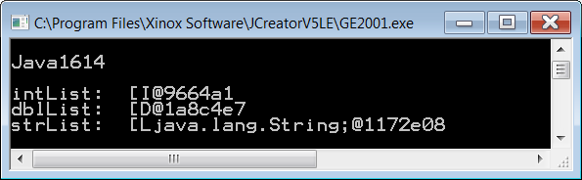
// Java1614.java
// This program demonstrates how Java <int> and <double> arrays are
// displayed when only the object identifier is printed.
public class Java1614
{
public static void main (String args[])
{
System.out.println("\nJava1614.java\n");
int intList[] = {11,22,33,44,55,66,77,88,99};
System.out.println("intList: " + intList);
System.out.println();
double dblList[] = {1.1,2.2,3.3,4.4,5.5,6.6,7.7,8.8,9.9};
System.out.println("dblList: " + dblList);
System.out.println();
String strList[] = {"Tom","Joe","Sue","Meg"};
System.out.println("strList: " + strList);
System.out.println();
}
}

Slide 41
Java1614 Graphic
intList
@16f0472
dblList
@18d107f
strList
@3b0eb0
16f0472
11
18d107f
1.1
3b0eb0
Tom
Each array variable is storing the memory
address of the first element in the array.

Slide 42
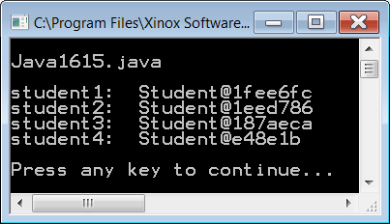
// Java1615.java
// In this program the user-defined <Student> class uses the <toString> method inherited from the
// <Object> class. The <Object> class <toString> method returns an actual string representation of
// the object value, which is a memory address.
public class Java1615
{
public static void main (String args[])
{
System.out.println("\nJava1615.java\n");
Student student1 = new Student("Tom",21,3.85);
Student student2 = new Student("Joe",17,3.65);
Student student3 = new Student("Sue",18,2.85);
Student student4 = new Student("Meg",19,3.90);
System.out.println("student1: " + student1);
System.out.println("student2: " + student2);
System.out.println("student3: " + student3);
System.out.println("student4: " + student4);
}
}
class Student
{
private String name;
private int age;
private double gpa;
public Student(String n, int a, double g) { name = n; age = a; gpa = g; }
}

Slide 43
The Original toString Method
print and println request display instructions from the toString method.
Method toString is defined by the Object class.
The Object class is the superclass for all Java classes.
This means that every class has access to the toString method.
The toString method, as defined by the Object class, returns the actual string representation values of all the primitive types like int, double, char and boolean.
toString returns the class name followed by the memory reference of any variable object.

Slide 44
“The mother of all classes” All classes automatically inherit from The Object Class
Object
toString
equals
Student
String
System
ArrayList
All other classes

Slide 45
Section 16.9
Redefining the
toString Method

Slide 46
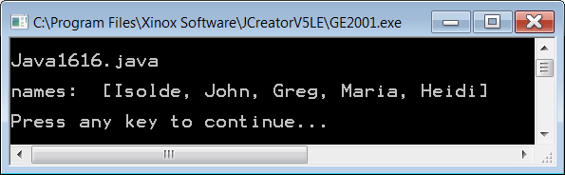
// Java1616.java
// This program demonstrates <toString> behaves differently for the <ArrayList>
// class. Note that "referenced" values are displayed, not the references.
import java.util.ArrayList;
public class Java1616
{
public static void main (String args[])
{
System.out.println("\nJava1616.java\n");
ArrayList names = new ArrayList();
names.add("Isolde");
names.add("John");
names.add("Greg");
names.add("Maria");
names.add("Heidi");
System.out.println("names: " + names);
System.out.println();
}
}

Slide 47
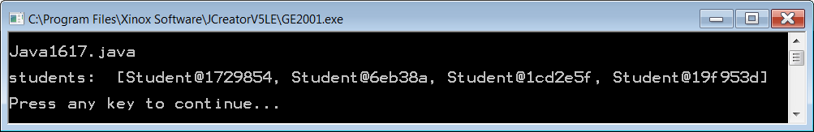
// Java1617.java
// The <toString> method of an ArrayList object displays the contents of the <ArrayList>
// object, but the non-Java class <Student> objects display memory addresses.
import java.util.ArrayList;
public class Java1617
{
public static void main (String args[])
{
System.out.println("\nJava1617.java\n");
ArrayList students = new ArrayList();
students.add(new Student("Tom",21,3.85));
students.add(new Student("Joe",17,3.65));
students.add(new Student("Sue",18,2.85));
students.add(new Student("Meg",19,3.90));
System.out.println("students: " + students);
System.out.println();
}
}
class Student
{
private String name;
private int age;
private double gpa;
public Student(String n, int a, double g) { name = n; age = a; gpa = g; }
}

Slide 48
ArrayList and toString
ArrayList objects display the actual individual array elements and not the memory reference of the object.
The output format looks like:
[Tom, Sue, Joe, Kathy]
This means that the toString method is redefined for the ArrayList class or some superclass of ArrayList.

Slide 49
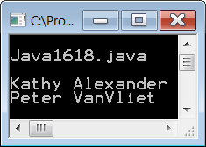
// Java1618.java
// This program demonstrates defining a <toString> method
// in the <Student> class so that it displays the name field of a <Student> object.
import java.util.ArrayList;
public class Java1618
{
public static void main (String args[])
{
System.out.println("\nJava1618.java\n");
Student student1 = new Student("Kathy Alexander",21,3.75);
Student student2 = new Student("Peter VanVliet",18,2.265);
System.out.println(student1.toString());
System.out.println(student2.toString());
System.out.println();
}
}
class Student
{
private String name;
private int age;
private double gpa;
public Student(String n, int a, double g) { name = n; age = a; gpa = g; }
public String toString() { return name; }
}

Slide 50
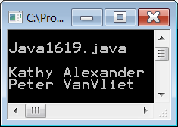
// Java1619.java
// This program is almost identical to the previous program.
// This time the <toString> method is not called by any <Student> object. Yet the result
// is the same because <println> uses the string representation of <toString> for its output.
import java.util.ArrayList;
public class Java1619
{
public static void main (String args[])
{
System.out.println("\nJava1619.java\n");
Student student1 = new Student("Kathy Alexander",21,3.75);
Student student2 = new Student("Peter VanVliet",18,2.265);
System.out.println(student1);
System.out.println(student2);
System.out.println();
}
}
class Student
{
private String name;
private int age;
private double gpa;
public Student(String n, int a, double g) { name = n; age = a; gpa = g; }
public String toString() { return name; }
}

Slide 51
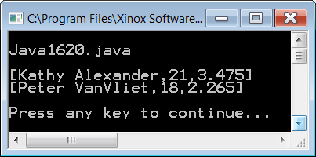
// Java1620.java
// This program demonstrates "redefining the <toString> method in the
// <Student> class so that it displays every field of a <Student> object.
// Note how this implementation resembles the <ArrayList> format.
import java.util.ArrayList;
public class Java1620
{
public static void main (String args[])
{
System.out.println("\nJava1620.java\n");
Student student1 = new Student("Kathy Alexander",21,3.75);
Student student2 = new Student("Peter VanVliet",18,2.265);
System.out.println(student1);
System.out.println(student2);
System.out.println();
}
}
class Student
{
private String name;
private int age;
private double gpa;
public Student(String n, int a, double g) { name = n; age = a; gpa = g; }
public String toString() { return "[" + name + "," + age + "," + gpa + "]"; }
}

Slide 52
Section 16.10
Redefining the
equals Method

Slide 53
Person class used in the next several programs
class Person
{
private String name;
private int age;
private char gender;
private double salary;
public Person(String n, int a, char g, double s)
{
name = n;
age = a;
gender = g;
salary = s;
}
public String toString()
{
return "[" + name + ", " + age + ", " + gender + ", " + salary + "]";
}
}

Slide 54
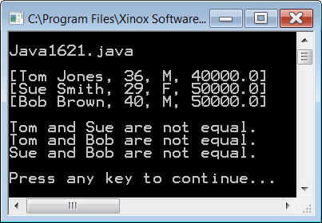
// Java1621.java
// This program tries to compares 2 person objects with the == operator.
// This does not work because the == operator only checks the shallow value.
// It also does not give us a way to determine how we will check for equality.
import java.util.ArrayList;
public class Java1621
{
public static void main (String args[])
{
System.out.println("\nJava1621.java\n");
Person tom = new Person("Tom Jones",36,'M',40000);
Person sue = new Person("Sue Smith",29,'F',50000);
Person bob = new Person("Bob Brown",40,'M',50000);
System.out.println(tom);
System.out.println(sue);
System.out.println(bob);
System.out.println();
if (tom == sue)
System.out.println("Tom and Sue are equal.");
else
System.out.println("Tom and Sue are not equal.");
if (tom == bob)
System.out.println("Tom and Bob are equal.");
else
System.out.println("Tom and Bob are not equal.");
if (sue == bob)
System.out.println("Sue and Bob are equal.");
else
System.out.println("Sue and Bob are not equal.");
}
}

Slide 55
Java1621 Graphic
tom
@16f0472
bob
@18d107f
sue
@3b0eb0
16f0472
Tom Jones | 36
$40,000.00 | ‘M’
18d107f
Sue Smith | 29
$50,000.00 | ‘F’
3b0eb0
Bob Brown | 40
$50,000.00 | ‘M’
The == operator is comparing the memory addresses,
just like it did with Strings.

Slide 56

// Java1622.java
// This program tries to compare 2 person objects with the equals method. This also does not work
// because we have not "redefined" the equals method for the Person class, and we are simply
// inheriting the equals method from the Object class, which only checks the shallow value.
import java.util.ArrayList;
public class Java1622
{
public static void main (String args[])
{
System.out.println("\nJava1622.java\n");
Person tom = new Person("Tom Jones",36,'M',40000);
Person sue = new Person("Sue Smith",29,'F',50000);
Person bob = new Person("Bob Brown",40,'M',50000);
System.out.println(tom);
System.out.println(sue);
System.out.println(bob);
System.out.println();
if (tom.equals(sue))
System.out.println("Tom and Sue are equal.");
else
System.out.println("Tom and Sue are not equal.");
if (tom.equals(bob))
System.out.println("Tom and Bob are equal.");
else
System.out.println("Tom and Bob are not equal.");
if (sue.equals(bob))
System.out.println("Sue and Bob are equal.");
else
System.out.println("Sue and Bob are not equal.");
}
}

Slide 57
Java1622 Graphic
tom
@16f0472
bob
@18d107f
sue
@3b0eb0
16f0472
Tom Jones | 36
$40,000.00 | ‘M’
18d107f
Sue Smith | 29
$50,000.00 | ‘F’
3b0eb0
Bob Brown | 40
$50,000.00 | ‘M’
While String has its own equals method, Person does not.
The result is we are using the equals method from the
Object class which also compares memory addresses.

Slide 58
// Java1623.java
// This program properly compares 2 person objects with the redefined equals method.
// It chooses to define "equality" solely based on a Person's salary, which may be
// overly capitalistic, but still makes a point.
import java.util.ArrayList;
public class Java1623
{
public static void main (String args[])
{
System.out.println("\nJava1623.java\n");
Person tom = new Person("Tom Jones",36,'M',40000);
Person sue = new Person("Sue Smith",29,'F',50000);
Person bob = new Person("Bob Brown",40,'M',50000);
System.out.println(tom);
System.out.println(sue);
System.out.println(bob);
System.out.println();
if (tom.equals(sue))
System.out.println("Tom and Sue are equal.");
else
System.out.println("Tom and Sue are not equal.");
if (tom.equals(bob))
System.out.println("Tom and Bob are equal.");
else
System.out.println("Tom and Bob are not equal.");
if (sue.equals(bob))
System.out.println("Sue and Bob are equal.");
else
System.out.println("Sue and Bob are not equal.");
}
}

Slide 59
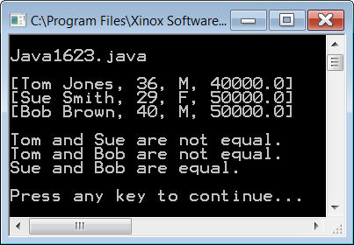
class Person
{
private String name;
private int age;
private char gender;
private double salary;
public Person(String n, int a, char g, double s)
{
name = n;
age = a;
gender = g;
salary = s;
}
public String toString()
{
return "[" + name + ", " + age + ", " + gender + ", " + salary + "]";
}
public boolean equals(Person temp)
{
return salary == temp.salary;
}
}

Slide 60
Java1623 Graphic
tom
@16f0472
bob
@18d107f
sue
@3b0eb0
16f0472
Tom Jones | 36
$40,000.00 | ‘M’
18d107f
Sue Smith | 29
$50,000.00 | ‘F’
3b0eb0
Bob Brown | 40
$50,000.00 | ‘M’
Now Person has its own equals method.
We chose to define equality based on salary.

Slide 61
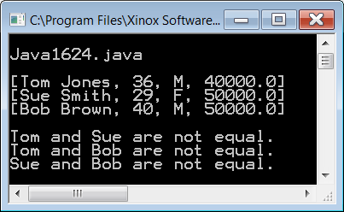
// Java1624.java
// This program defines equality differently from the previous programs.
// Now all data fields must match for 2 Person objects to be considered equal.
// A special <this> reference in the equals method helps to distinguish the 2 objects.
// NOTE: It is not uncommon for the equals method from one class to call the
// equals method from another class.
public boolean equals(Person that)
{
return this.name.equals(that.name) &&
this.age == that.age &&
this.gender == that.gender &&
this.salary == that.salary;
}

Slide 62
Java1624 Graphic
tom
@16f0472
bob
@18d107f
sue
@3b0eb0
16f0472
Tom Jones | 36
$40,000.00 | ‘M’
18d107f
Sue Smith | 29
$50,000.00 | ‘F’
3b0eb0
Bob Brown | 40
$50,000.00 | ‘M’
In this case, the redefined equals method
bases equality on all 4 fields in the record.

Slide 63
Arrays and Equality
Two arrays (static or dynamic) are considered equal if they are the same size, and they store the same information at each and every index.

